Slide 1
Blockchain & Legal Innovation II
Lecture 2 – Token Engineering & Ecosystem

Slide 2
Traditional View of Legal Work
Law as a Project High Expertise Significant Project Management Significant Support Resources E + S | Law as a Process Low Expertise Low-Moderate Management Significant Support Resources e + S
Law as a Person High Expertise Low-Moderate Management Insignificant Support Resources E + S | Law as a Program Expertise, management and support embedded in software application. 0110 + $$$
The Law

Slide 3
Types of Legal Work
Advisory No other party Assisting client to deal with outside | Transactional Dealing with outside world on client’s behalf Other parties are willing participants in the transaction
Prosecutorial Dealing with outside world on client’s behalf In the context of a court or tribunal One party is the State in its law-enforcement capacity | Litigious Dealing with outside world on client’s behalf In the context of a court or tribunal At least one party is an unwilling participant

Slide 4
Scales of Legal Work
Law as a Project High Expertise Significant Project Management Significant Support Resources E + S | Law as a Process Low Expertise Low-Moderate Management Significant Support Resources e + S
Law as a Person High Expertise Low-Moderate Management Insignificant Support Resources E + S | Law as a Program Expertise, management and support embedded in software application. 0110 + $$$

Slide 5
Traditional Legal Work Map
Program | Process | Process | Program
Person | Project | Project | Person
Person | Project | Project | Person
Program | Process | Process | Program
Advisory Services
Transactional Services
LAW
FIRMS
Prosecutorial Services
Litigious Services

Slide 6
Map of Traditional Law Firm
Program Website | Process Wills | Process Conveyancing | Program Website
Advice & Docs Person | Tax Structuring Project | Business Sale Project | Start ups Person
Person DUIs | Project Murder | Project Building Dispute | Person ADR
Program Website | Process N/A | Process Debt recovery | Program Website
Advisory Services
Transactional Services
LAW
FIRMS
Prosecutorial Services
Litigious Services

Slide 7
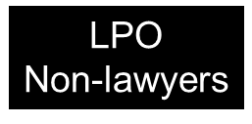
Now A Crowded Space
Program | Process | Process | Program
Person | Project | Project | Person
Person | Project | Project | Person
Program | Process | Process | Program
Apps
LPO
Non-lawyers
Apps
Advisory Services
Transactional Services
Barristers, Contract
Lawyers, Micro firms
In-House Counsel
LAW
FIRMS
Barristers, Contract
Lawyers, Micro firms
In-House Counsel
Prosecutorial Services
Litigious Services
Apps
Apps

Slide 8
People Want Services Appropriate to Scale
DIFY | Projects
 | Processes
HYH
 | People
DIY | Programs
Split service into layers of client autonomy
DIY: Do It Yourself
HYH: Hold Your Hand
DIFY: Do It For You
Each service layer will tend to suit a different scale of work.

Slide 9
Now Exposing The Legal Platform
Project | Process
Person | Program
Legal Platform

Slide 10
Law as Platform
Current Legal Platform
Matter-By-Matter Paper-based laws Human Lawyers & Law Firms Physical Courts (Court as a place) Bespoke services Monolithic – no choice
Digital Platform
End-to-End Solutions Digital Laws Robot Lawyers Court as a service Generic solutions Differential offerings with on-ramps and off-ramps for high-touch needs.

Slide 11
The Lex Automagica Tech Stack
AR/VR: Conceptual Made Real
AI/ML: Automated Determinations
Smart Contracts: Automated Executions
Tokenisation/DA: Markets for anything of value
Blockchain/DLT: Decentralised Ledgers/Truth

Slide 12
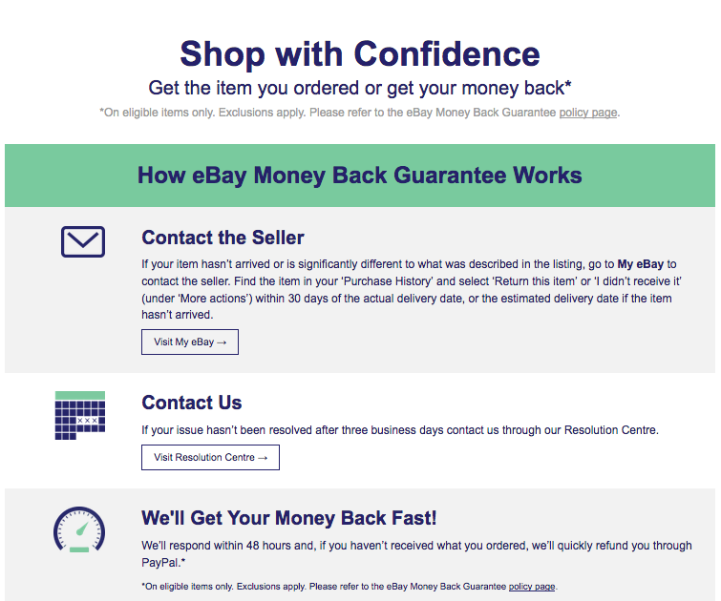
Ebay – Law as a Platform
As of 2014, Ebay handles over 60 million ecommerce disputes annually.
Without low cost dispute and insurance, ebay can’t do what it does.

Slide 13

Employsure – Comprehensive Employment Solutions

Slide 14

Can We Scale Justice?
Lex Automagica
Legal Processes
Smart Contracts
AI/ML
AR/VR
Tokens
Blockchain

Slide 15
The Law Only Deals With 4 Things
People
Things
Relationships
Disputes
Individuals
Corporations
Money
Property
Shares
Data
Definitions
Rights
Consent
ADR
Tribunals
Courts
Obligations
AI?
Code

Slide 16
Blockchain is Trying To Automate Law
People
Things
Relationships
Disputes
Sovrin
SelfKey
Bitcoin
STOs
OpenLaw
DeFi
Kleros
OpenCourt
JUR
Supply Chains
Civic
Propy
Chainlink

Slide 17
6 – The Possibility of Automating Laws
The Off-Chain/On-Chain Membrane
Problem is moving from off chain to on-chain, analogue to digital
Bitcoin works because bitcoins are created on-chain.
Generally need to trust a third party – introduces counter-party risk (e.g. governments putting land titles on blockchains)
Trusted third parties are security holes and lawyer magnets
Smart Contracts and AI may partly solve this problem
Blockchain can “prove” existence and ownership
Smart Contracts and AI can regulate relationship
Off chain mechanisms can handle disputes and exceptions;
The main problem is moving from the real world to the blockchain.

Slide 18
The Vision: Integrated Automation
People
Things
Relationships
Disputes
Self-KYC
Digital Companies
Currencies
Securities
Dapps
Decentralized Dispute Resolution Protocols
Smart Contracts
Self Governing Machines
Property
Privileges
Data
Use-Specific Platforms
Off-Ramps to Traditional Forums

Slide 19
It’s About Scaling Justice
Internet Exploded Information Sharing But Not Trust
Can’t Run a Ferrari on Dirt Roads
The Scales of Justice Have Not Scaled
Can Tech Solve The Problem?

Slide 20
Examples

Slide 21
Examples
Digital Cows:
Australia already has a comprehensive paper-based quality control system that aims to track cows from birth to slaughter. Essentially, we would be looking at “tokenising” and therefore “scaling” the trust that system provides to deliver a near-instant and near-costless buying and selling part-ownership of cattle 24/7/365.

Slide 22
Solicitors’ Trust Accounting on Blockchain: Solicitors have lots of regulation surrounding how they use client funds. Those rules are costly to police and regularly breached. Conceptually, it should be possible to turns the regulations into smart contracts.

Slide 23
Residential Tenancies: Residential tenancy arrangements are highly regulated, but disputes are common, especially over payment and return of bonds, and the most vulnerable people are least able to enforce their rights in a dispute. Potentially, blockchain and smart contracts should be able to automate a lot of this to substantially improve compliance and tenant rights.

Slide 24
Company Secretarial Services: There is a lot of talk about tokenized securities, but the market is actually much broader. Most companies are small business entities, but the whole process of registering, managing, selling and liquidating companies is a pain for the average small business. It should be possible for this whole process run more smoothly through smart contracts with shares represented as tokens issued on a public blockchain.

Slide 25
Employment Law & Awards: Awards are complicated minimum standards for setting employment obligations. They are regularly breached. Is it posisble to automate compliance with all or some aspect of employment obligations using public blockchains and smart contracts? Could changes or improvements be made to the current system to facilitate automated compliance?

Slide 26
Living Receipts: Consumer law is detailed and complex. Enforcing rights is often more costly than the transaction involved. Is it possible to make consumer rights automatic? Can the fact of payment be fused with a system of tokenised rights managed through blockchain and smart contracts so that consumers and retailers can instantly exercise their rights? Can we build E-Bay without ebay in the middle?

Slide 27
Others:
Automated Sale of Businesses;
Smart contracts for telecommunication;
Smart contracts for banking;
Tokenisation of Taxation – micro payments and alternative tax regimes;
Tokenisation of Remote Community Funding or Other Government Funding Programs

Slide 28
Issues
Governance
Oracles and APIs
Money
Securities
Identity & Roles

Slide 29
Governance
Not-for-profit
Co-operative
DAO
Members?
Power over Protocol?
Power over Capital
More power?
Governance token (transferrable or not)

Slide 30
Oracles and APIs
How does the chain know about the outside world?
People?
Machines?
Groups of people?
Groups of machines?
APIs
Legislated obligations?

Slide 31
Money
How does value get onto and move around your platform?
Compliance with Money transmission laws
Compliant Stablecoin?

Slide 32
Securities
How does your system comply with securities/fundraising laws?
Corporate entity?
Managed investment scheme?
Qualified investors only?

Slide 33
Managed Investment Scheme
A scheme that has the following features:
people contribute money or money’s worth as consideration to acquire rights (interests) to benefits produced by the scheme (whether the rights are actual, prospective or contingent and whether they are enforceable or not)
any of the contributions are to be pooled, or used in a common enterprise, to produce financial benefits, or benefits consisting of rights or interests in property, for the people (the members) who hold interests in the scheme (whether as contributors to the scheme or as people who have acquired interests from holders)
the members do not have day-to-day control over the operation of the scheme (whether or not they have the right to be consulted or to give directions).
s9 Corporations Act 2001 (CTH)

Slide 34
Identity and Roles
Do you need to know people’s identity?
Does formal KYC need to happen?
If so, how?
Do different users have different roles?
How are those roles assigned?

Slide 35
Inter-related
All these decisions tend to impact the other.
It’s a bit like solving a Rubic’s cube.

